Slide 1

Final Project
Adam Kolodny
Coding Dojo

Slide 2
Background
FitTrip is a fitness app available in the Apple Store
It tracks both indoor and outdoor activities
Indoors, using a patented technology, it interacts with video content utilizing your heart rate. The video moves faster when heart rate is increased in a proportional manner.

Slide 3
Project Objective
The Company wishes to start a new marketing campaign in the 4th quarter in time for the holidays. It would like to be able to pinpoint what audiences it should be marketing & what aspects of the app are important to so be most effective in its marketing.
The objective of this project is 2 fold:
Analyze the population of those that downloaded the app
To create a model that can predict who will use the app after downloading

Slide 4
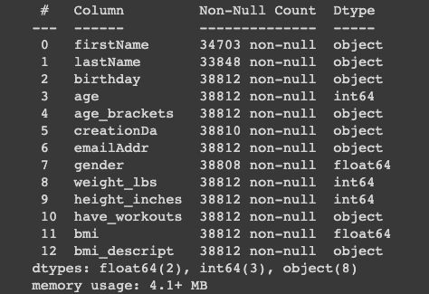
Data
The following features were eliminated from the analysis FirstName, lastName, birthday, creationDa, emailAddr The following features were categorical and were treated as such: age_brackets, bmi_descript

Slide 5
Phase 1 Data Analysis

Slide 6
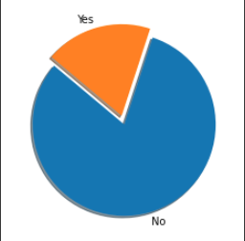
Customers who have done workouts
20%
80%

Slide 7
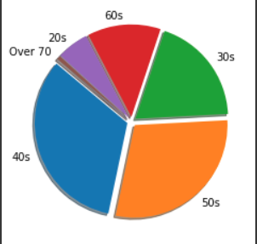
Users by Age brakets

Slide 8
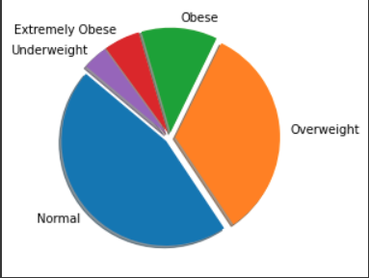
Users by BMI categories

Slide 9
Phase 2 Model

Slide 10
Models
In designing my model I used:
Decision Tree Classifier
Kneighbors Classifier
Logistic Regression Classifier
To further tune my models, I used:
Voting Classifier
Hard, soft and weighted
Pipeline
GridSearch

Slide 11
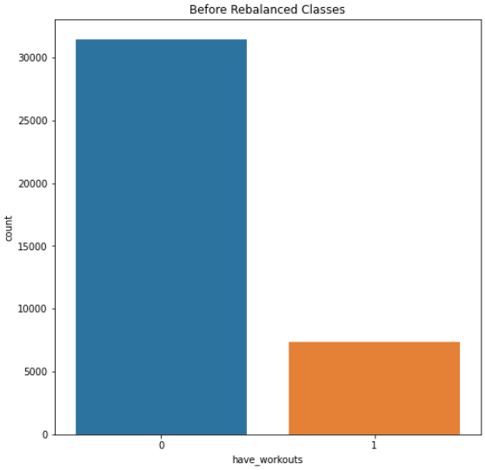
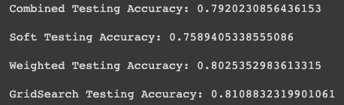
Results Pre balancing of data

Slide 12
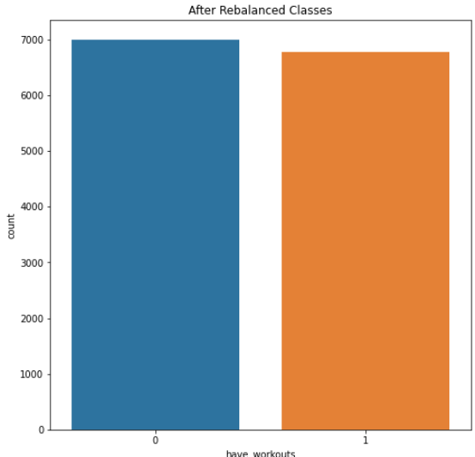
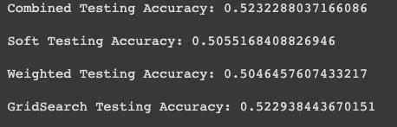
Results Post balancing of data

Slide 13
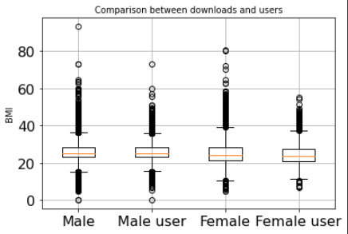
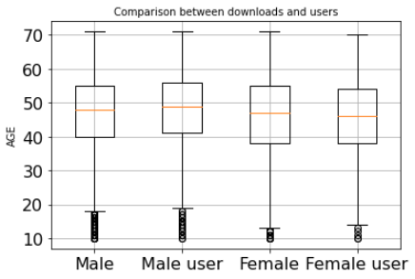
Conclusion
It is evident from the analysis of the models that were run that there does not exist any real correlation in the data that would indicate whether a person who downloads the app will become a user.
This conclusion can be seen pre balancing which resulted in an 80% accuracy which is the close to the split of non-users vs post balancing of 50% which is the split on the balanced data.
Conclusion is that marketing needs to focused on all users who download to entice them to use the app.
BMI
AGE

Slide 14
Phase 3 Future

Slide 15
Future discovery
Next phase
There is much more data available within our database.
The next phase of this analysis will be to expand on what has been done adding in
Location
Indoor vs outdoor workouts
Run vs Bike workouts
Analyze the workouts being done to determine who to target
Collect more relevant data at registration which will help in future data analysis.

